Slide 1
Research Topic: Crowd Detection and Analysis
By David Zeng
Mentor: Professor Hao Tang
Graduate Student Mentor: Greg Olmschenk

Slide 2
Overview
What is crowd detection?
  Applications
Background on our project
  What is our plan?
My focus for this project
Things that I will learn or improve on
Overview of basic computer vision methods

Slide 3
What is Crowd Analysis?
Basic definition: Analyzing crowds
  Observing crowds to obtain useful information that provides more insight to how crowds act or react.
Research areas of crowd analysis:
  Recognition, monitoring and behavior of people.
    People counting
    People tracking
    Behavior understanding
We have face detection apps on our phones! Why can’t we use those algorithms?
  Dense crowds
  Different angles and poses
  Face recognition works differently

Slide 4
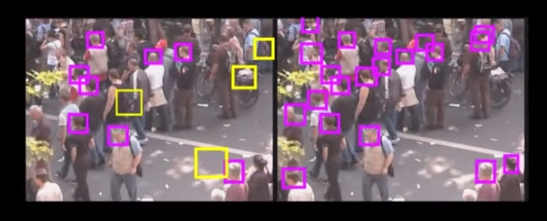
Example of a current crowd detection algorithm.
Left: Basic Head detection Right: Density aware head detection
Source: Mikel Rodriguez, “Density aware person detection and tracking in crowds” Youtube video

Slide 5
Applications of Crowd Analysis
Crowd Management
  Developing management strategies to avoid crowd related disasters and insuring public safety
Public Space Design
  Provide guidelines of public spaces
Virtual Environments
  Developing mathematical models for computer simulations
Visual Surveillance
  Use for automatic detection of anomalies and setting off alarms
Intelligent Environments
  Creating a area that deals with crowds in a simple and efficient way
    Designing buildings that avoid bottlenecks and promote safety and efficiency

Slide 6
Applications (cont.)
Additional Applications :
  Using computer simulations to simulate realistic crowd scenarios to aid crowd management studies.
  Using real life video data to develop and test simulations
  Using computer simulations to test algorithms designed for live data.

Slide 7
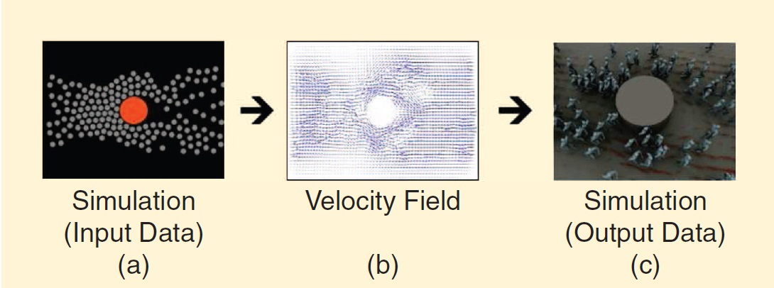
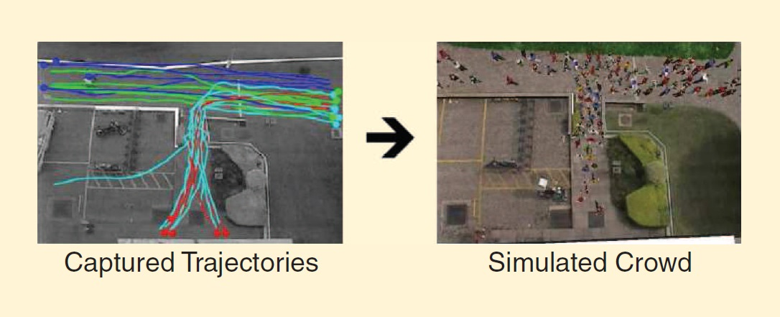
Above: Examples of simulations
Source: Crowd Analysis Using Computer Vision Techniques Survey in SEPTEMBER 2010 IEEE SIGNAL PROCESSING MAGAZINE

Slide 8
Background on the Project
Fatal bus accident in march of this year halted operations
  Caused unexpectedly huge crowds
Port Authority would like to figure out how to better manage huge crowds to prepare for critical situations.
  How do people react to these situations?
  Where do they go?
  Can this research data help create better management systems for P.A.?
Professor Hao Tang and another separate CCICADA graduate student team from Rutgers are working with Port Authority for their own respective projects
  CCICADA team will be working on computer simulations of crowds at port authority.
  Our Team on people counting, working with video data provided by Port Authority.

Slide 9
How are we going to approach this?
We don’t know yet!
The algorithms out there all work differently and or specifically with varying techniques and their own pros and cons.
We still need to acquire more data from Port Authority
  Is it possible to track people through multiple cameras if port authority cameras do not have enough coverage area?
  Can we work around corrupted video data that was given?
    Is there a way to fix or obtain better data?
  Do we need to set up our own cameras and are we allowed to do that?

Slide 10
My Focus
Preprocessing video data
  Setting and cleaning up data before we start using it.
Preparing ground truth labeling
    Ground truth in this case is basically having a manually calculated value to test for the accuracy of our algorithms
      In our case: manually counting each person in a frame
      Also potentially tracking specific people from frame to frame
Evaluation and testing the different algorithms.
  Debugging code

Slide 11
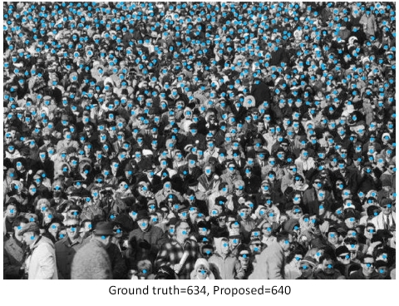
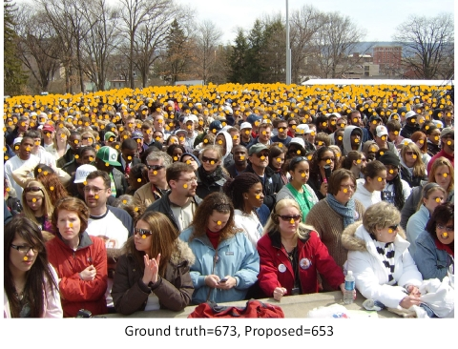
Some examples of manual people counting.

Slide 12
Things I hope to Learn or Improve on
Computer vision techniques
Improving my programming skills
Improving my debugging skills
Getting more comfortable with version control
Learning how to work in a coding team and practicing good software development techniques

Slide 13
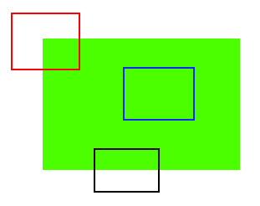
Overview of Computer Vision
Using computers images or video to automate vision processes.
  Recognizing, locating, tracking objections and actions.
    How can a computer know what it is looking at?
Relevant Techniques
Feature extraction
  Harris Corner Detection, SIFT, SURF, FAST, BRIEF, ORB algorithms used to get interesting features that will be used to detect things
  Interesting features are distinctive and that can be easily tracked
Corners are much more distinct and easier to find and recognized when compared to “edges” or “flat surfaces”

Slide 14
Overview of Computer Vision (cont.)
Background subtraction
  Getting rid of the static background to focus on the important stuff.
  Sort of like reverse movie green screen.
Tracking
  Meanshift, Camshift, and Optical Flow are used to flow movements by following pixel density

Slide 15
END

